Slide 1
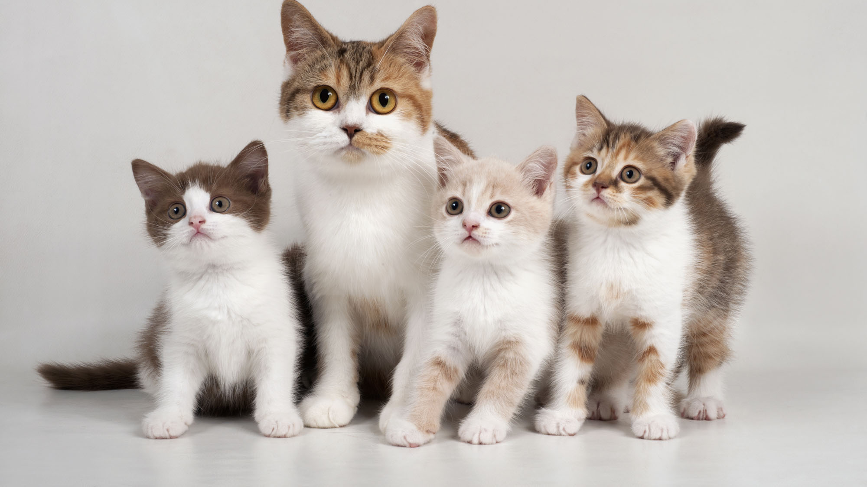
Cat Classifier
Breed – Age – Gender Joe Turner

Slide 2
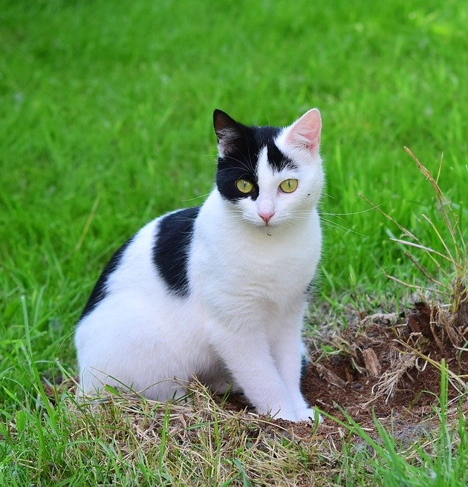
Dataset - Images
Cat Breeds Dataset
Images for 67 different cat breeds as labeled by advertisers for adoption
Size: 2GB
We have an unbalanced dataset of images representing 67 different cat breeds.
Disclaimer: These breeds has been selected by advertisers and not by professionals, there is a probability of error in some of them
https://www.kaggle.com/ma7555/cat-breeds-dataset

Slide 3
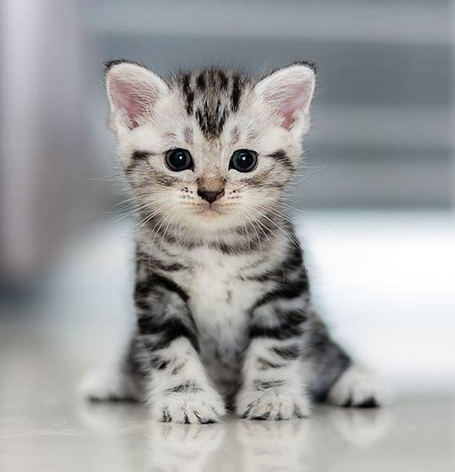
Dataset - CSV
ID linking data to image
Age: Baby, Young, Adult, Senior
Gender: Male, Female, Unknown
Size: Small, Medium, Large
Coat: Short, Medium, Long

Slide 4
The Original Idea
Use KNN to predict a cat’s breed
Then use the images of that predicted breed and KNN to predict:
Age
Gender
Size
Coat

Slide 5

The problems
Tens of thousands of images take over an hour to process
KNN has terrible accuracy even when hyperparameters are tuned
Tuning hyperparameters increases the time of each run.
Not enough time to spend over an hour on each run

Slide 6
The Idea
Reduce the size of the dataset
Build a neural network to predict a cat’s breed
Use the predicted breed to build neural networks specific to that breed of cat:
Network to predict age
Network to predict gender
Example:
Breed NN predicts Calico
Build NN from Calico images to predict age and gender.

Slide 7
Dataset Used: 55 Breeds – 8,324 Images
Abyssinian: 247 | Burmese: 193 | Havana: 164 | Persian: 166 | Snowshoe: 172
American Bobtail: 165 | Calico: 169 | Himalayan: 163 | Pixiebob: 108 | Somali: 34
American Curl: 144 | Chartreux: 83 | Japanese Bobtail: 125 | Ragamuffin: 131 | Sphynx - Hairless Cat: 209
American Shorthair: 152 | Chausie: 23 | Maine Coon: 173 | Ragdoll: 168 | Tabby: 185
American Wirehair: 19 | Cornish Rex: 171 | Munchkin: 181 | Russian Blue: 168 | Tiger: 175
Applehead Siamese: 133 | Cymric: 17 | Nebelung: 146 | Scottish Fold: 378 | Tonkinese: 168
Balinese: 253 | Devon Rex: 116 | Norwegian Forest Cat: 181 | Selkirk Rex: 75 | Torbie: 168
Bengal: 166 | Dilute Calico: 171 | Ocicat: 118 | Siamese: 155 | Tortoiseshell: 177
Birman: 225 | Dilute Tortoiseshell: 175 | Oriental Long Hair: 37 | Siberian: 186 | Turkish Angora: 166
Bombay: 173 | Egyptian Mau: 187 | Oriental Short Hair: 182 | Silver: 89 | Turkish Van: 173
British Shorthair: 174 | Exotic Shorthair: 174 | Oriental Tabby: 101 | Singapura: 22 | Tuxedo: 150

Slide 8
The Models
All Sequential
Convolutional layers:
Increasing filters
Deacreasing kernels
Sometimes padding
Sometimes decreasing strides
Activation: relu
Pooling between layers
Some use flatten before dense layers
Dense layers:
Decreasing units
Activation: relu, sigmoid, softmax
Some use dropout before final dense layer

Slide 9
Compiling models
Breed
Loss: categorical cross entropy
Optimizer: sigmoid
Age
Loss: categorical cross entropy
Optimizer: adagrad
Gender
Loss: binary cross entropy
Optimizer: rmsprop

Slide 10
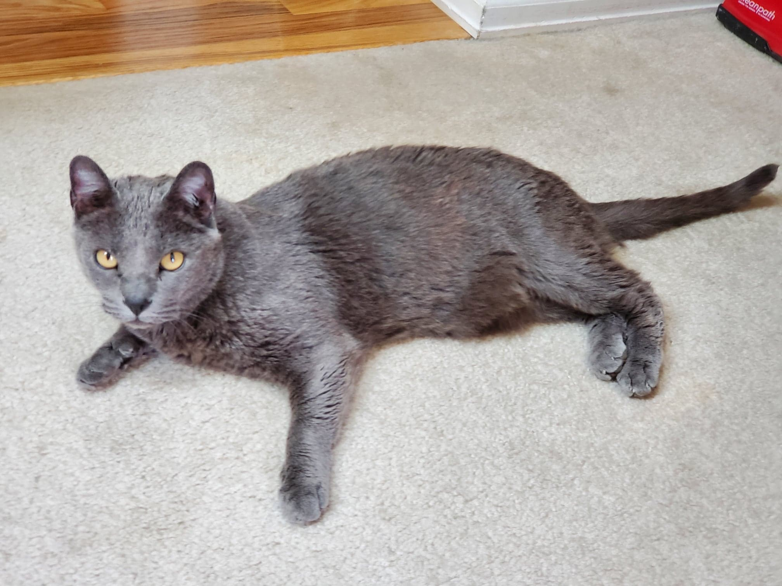
Let’s Predict A Cat
Name: Mr. Miles
Breed: Unknown
Age: Adult
Gender: Male

Slide 11
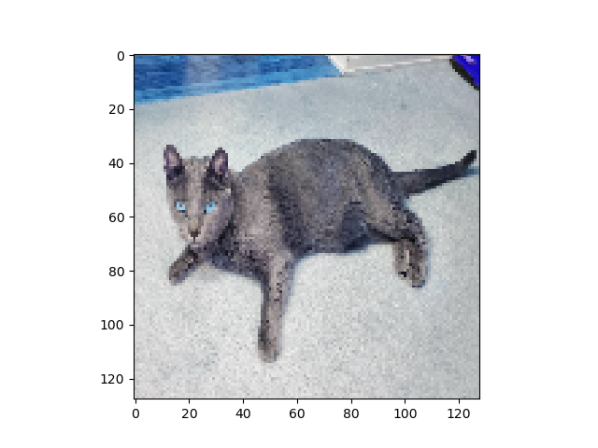
Image Before & After Resizing/Flattening
Images Resized to 128x128
Then Flattened

Slide 12
Breed: 5 Epochs – Batch Size 32
Train on 6243 samples, validate on 2081 samples
Epoch 1/5
6243/6243 [==============================] - 146s 23ms/step - loss: 3.9415 - accuracy: 0.0407 - val_loss: 3.9291 - val_accuracy: 0.0351
Epoch 2/5
6243/6243 [==============================] - 152s 24ms/step - loss: 3.9148 - accuracy: 0.0437 - val_loss: 3.8875 - val_accuracy: 0.0341
Epoch 3/5
6243/6243 [==============================] - 148s 24ms/step - loss: 3.8196 - accuracy: 0.0548 - val_loss: 3.8161 - val_accuracy: 0.0553
Epoch 4/5
6243/6243 [==============================] - 147s 24ms/step - loss: 3.5933 - accuracy: 0.0982 - val_loss: 3.8857 - val_accuracy: 0.0505
Epoch 5/5
6243/6243 [==============================] - 147s 24ms/step - loss: 2.9392 - accuracy: 0.2478 - val_loss: 4.1275 - val_accuracy: 0.0553

Slide 13
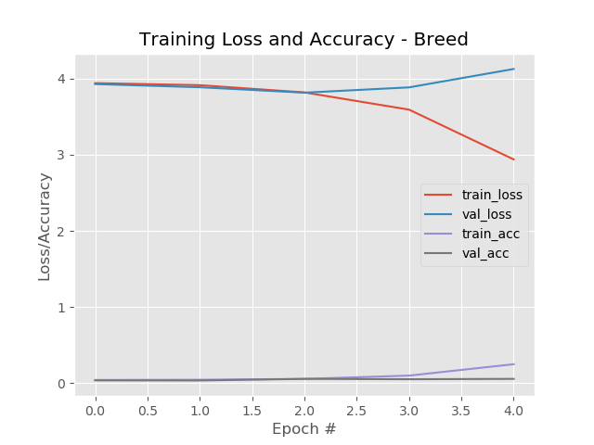
Breed: 5 Epochs – Batch Size 32
Train on 6243 samples
Validate on 2081 samples
Accuracy: 0.06
Predicted breed: Scottish Fold
Prediction: Bad

Slide 14
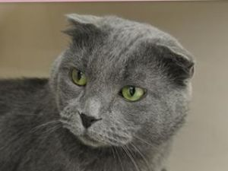
Breed Prediction: Bad
Mystery Breed
Scottish Fold

Slide 15
Age: 5 Epochs – Batch Size 32
Train on 283 samples, validate on 95 samples
Epoch 1/5
283/283 [==============================] - 2s 7ms/step - loss: 6.4316 - accuracy: 0.3357 - val_loss: 1.5352 - val_accuracy: 0.2947
Epoch 2/5
283/283 [==============================] - 2s 7ms/step - loss: 1.3316 - accuracy: 0.4205 - val_loss: 1.1013 - val_accuracy: 0.5684
Epoch 3/5
283/283 [==============================] - 2s 7ms/step - loss: 1.1875 - accuracy: 0.5406 - val_loss: 1.0561 - val_accuracy: 0.5684
Epoch 4/5
283/283 [==============================] - 2s 7ms/step - loss: 1.1458 - accuracy: 0.5371 - val_loss: 1.0811 - val_accuracy: 0.5684
Epoch 5/5
283/283 [==============================] - 2s 7ms/step - loss: 1.1115 - accuracy: 0.5689 - val_loss: 1.1293 - val_accuracy: 0.5263

Slide 16
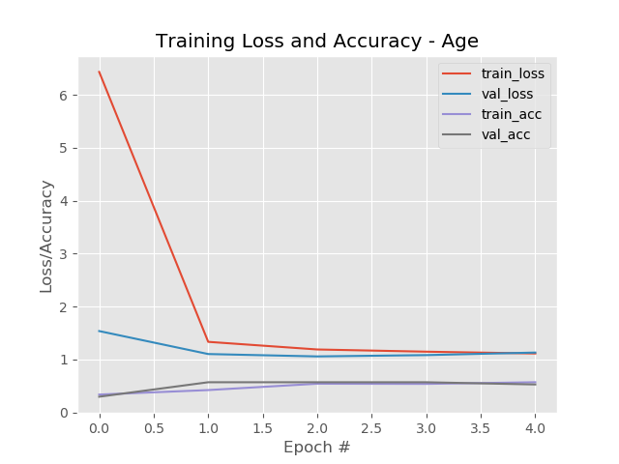
Age: 5 Epochs – Batch Size 32
Train on 283 samples
Validate on 95 samples
Accuracy: 0.53
Predicted age: Adult
Actual age: Adult
Prediction: Correct

Slide 17
Gender: 5 Epochs – Batch Size 32
Train on 283 samples, validate on 95 samples
Epoch 1/5
283/283 [==============================] - 2s 8ms/step - loss: 2.3828 - accuracy: 0.4982 - val_loss: 0.7091 - val_accuracy: 0.4579
Epoch 2/5
283/283 [==============================] - 2s 7ms/step - loss: 0.6886 - accuracy: 0.5512 - val_loss: 0.6993 - val_accuracy: 0.4789
Epoch 3/5
283/283 [==============================] - 2s 7ms/step - loss: 0.6664 - accuracy: 0.6095 - val_loss: 0.7410 - val_accuracy: 0.4526
Epoch 4/5
283/283 [==============================] - 2s 7ms/step - loss: 0.6420 - accuracy: 0.6343 - val_loss: 0.7330 - val_accuracy: 0.4474
Epoch 5/5
283/283 [==============================] - 2s 7ms/step - loss: 0.6610 - accuracy: 0.6855 - val_loss: 0.7493 - val_accuracy: 0.4368

Slide 18
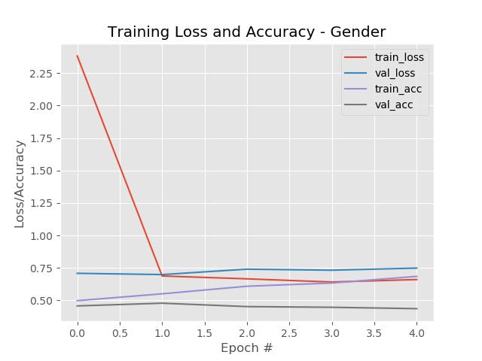
Gender: 5 Epochs – Batch Size 32
Train on 283 samples
Validate on 95 samples
Accuracy: 0.46
Predicted gender: Female
Actual gender: Male
Prediction: Bad

Slide 19
Breed: 10 Epochs – Batch Size 64
Train on 6243 samples, validate on 2081 samples
Epoch 1/10
6243/6243 [==============================] - 117s 19ms/step - loss: 3.9272 - accuracy: 0.0423 - val_loss: 3.8926 - val_accuracy: 0.0428
Epoch 2/10
6243/6243 [==============================] - 118s 19ms/step - loss: 3.8398 - accuracy: 0.0537 - val_loss: 3.8465 - val_accuracy: 0.0490
…
Epoch 8/10
6243/6243 [==============================] - 119s 19ms/step - loss: 0.4483 - accuracy: 0.8842 - val_loss: 6.4192 - val_accuracy: 0.0721
Epoch 9/10
6243/6243 [==============================] - 118s 19ms/step - loss: 0.1448 - accuracy: 0.9696 - val_loss: 7.4723 - val_accuracy: 0.0740
Epoch 10/10
6243/6243 [==============================] - 120s 19ms/step - loss: 0.0690 - accuracy: 0.9869 - val_loss: 8.1053 - val_accuracy: 0.0687

Slide 20
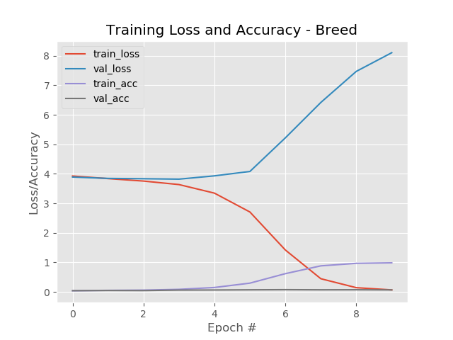
Breed: 10 Epochs – Batch Size 64
Train on 6243 samples
Validate on 2081 samples
Accuracy: 0.07
Predicted breed: Chartreux

Slide 21
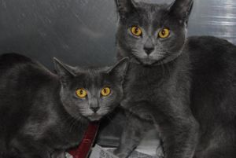
Breed Prediction: Better
Mystery Cat
Chartreux

Slide 22
Age: 10 Epochs – Batch Size 64
Train on 62 samples, validate on 21 samples
Epoch 1/10
62/62 [==============================] - 1s 8ms/step - loss: 1.3686 - accuracy: 0.3387 - val_loss: 35.9386 - val_accuracy: 0.6190
Epoch 2/10
62/62 [==============================] - 0s 6ms/step - loss: 55.4884 - accuracy: 0.4032 - val_loss: 31.6081 - val_accuracy: 0.1905
…
Epoch 8/10
62/62 [==============================] - 0s 6ms/step - loss: 1.3043 - accuracy: 0.4194 - val_loss: 1.8031 - val_accuracy: 0.0952
Epoch 9/10
62/62 [==============================] - 0s 6ms/step - loss: 1.2588 - accuracy: 0.5000 - val_loss: 1.2647 - val_accuracy: 0.2381
Epoch 10/10
62/62 [==============================] - 0s 6ms/step - loss: 0.8906 - accuracy: 0.7581 - val_loss: 1.2384 - val_accuracy: 0.2857

Slide 23
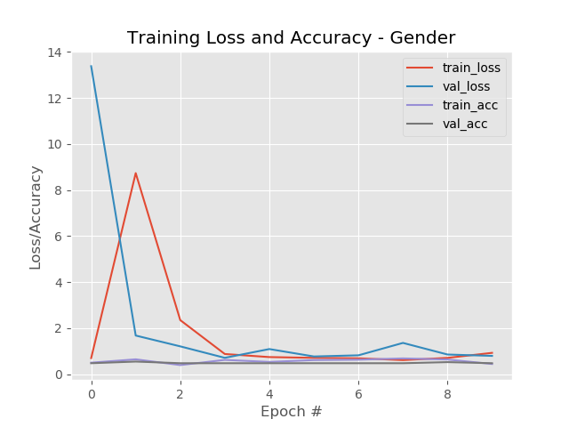
Age: 10 Epochs – Batch Size 64
Train on 62 samples
Validate on 21 samples
Accuracy: 0.29
Predicted age: Young
Actual age: Adult
Prediction: Bad

Slide 24
Gender: 10 Epochs – Batch Size 64
Train on 62 samples, validate on 21 samples
Epoch 1/10
62/62 [==============================] - 1s 9ms/step - loss: 0.6981 - accuracy: 0.5000 - val_loss: 13.3760 - val_accuracy: 0.4762
Epoch 2/10
62/62 [==============================] - 0s 7ms/step - loss: 8.7332 - accuracy: 0.6452 - val_loss: 1.6781 - val_accuracy: 0.5476
…
Epoch 8/10
62/62 [==============================] - 0s 7ms/step - loss: 0.6123 - accuracy: 0.6855 - val_loss: 1.3582 - val_accuracy: 0.4762
Epoch 9/10
62/62 [==============================] - 0s 7ms/step - loss: 0.7076 - accuracy: 0.6371 - val_loss: 0.8544 - val_accuracy: 0.5238
Epoch 10/10
62/62 [==============================] - 0s 6ms/step - loss: 0.9266 - accuracy: 0.4435 - val_loss: 0.7952 - val_accuracy: 0.4762

Slide 25
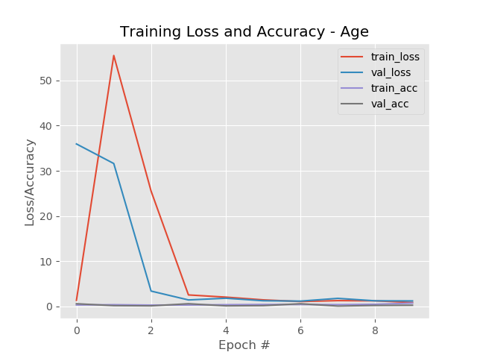
Gender: 10 Epochs – Batch Size 64
Train on 62 samples
Validate on 21 samples
Accuracy: 0.48
Predicted breed: Male
Actual Breed: Male
Prediction: Good

Slide 26
Observations & Challenges
Dataset had numerous images of non-cat animals such as dogs and rabbits.
Numerous images in one breed folder had a different breed listed in the CSV
Breed prediction varied wildly with numerous breeds and few images of each breed.
Time to run networks after each change was at least 20 minutes.
Predictions were better with fewer breeds and more images per breed.

